Slide 1

SMART Car ParKING sySTEM
The best way to enhance security for our cars
Diganta Moulik Roll no.: 213012-21-0284
Subhra pratim mOndal roll no.: 213012-21-0288
Anshuman sarkar Roll no.: 213012-21-0147
Swarup Ghosh Roll no.: 213012-21-0137
Under the Guidance
of
SHILPA SAHA

Slide 2
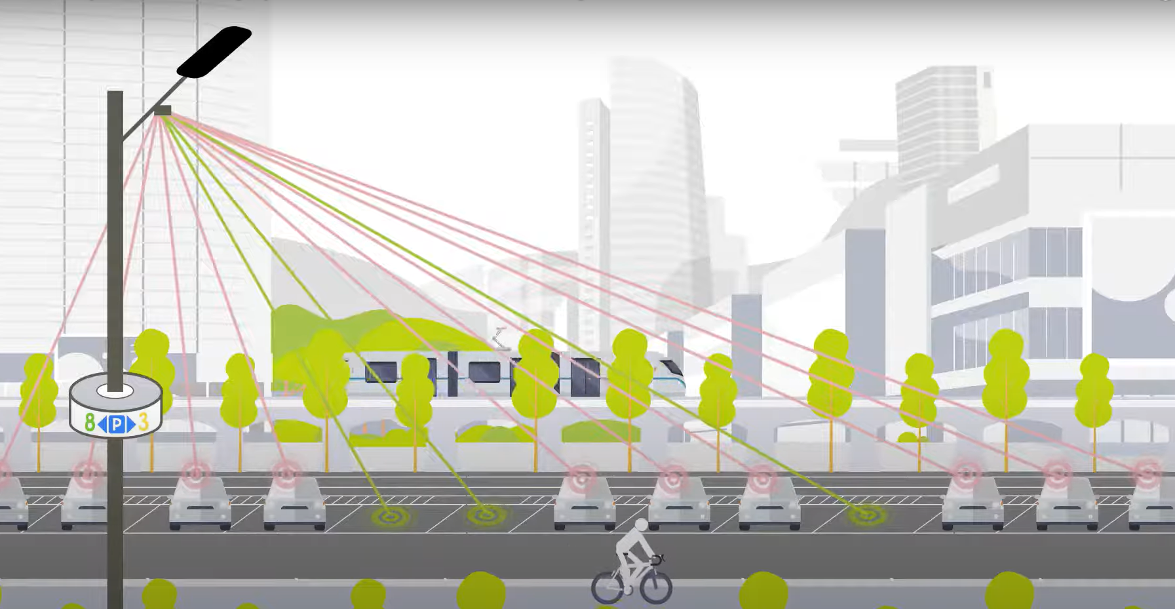
Contents:
Introduction
Motivation
Requirement analysis specification
Dataset Description
Implementation & design
Results and discussions
Conclusion and Future work
References
Acknowledgement
.

Slide 3
INTRODUCTION/DOMAIN DESCRIPTION:
Welcome to our presentation on the Smart Car Parking System. With the increasing demand for efficient parking solutions in urban areas, traditional methods often fall short, leading to frustration, wasted time, and traffic congestion.
Our project aims to revolutionize the parking experience with a smooth user interface that allows users to easily book a parking slot at their destination.
In our project we have mainly focused on the Machine learning for the car detection, Database Management System for storing the user’s data, the data of the locations and Web Designing to make a user friendly interface.
.

Slide 4
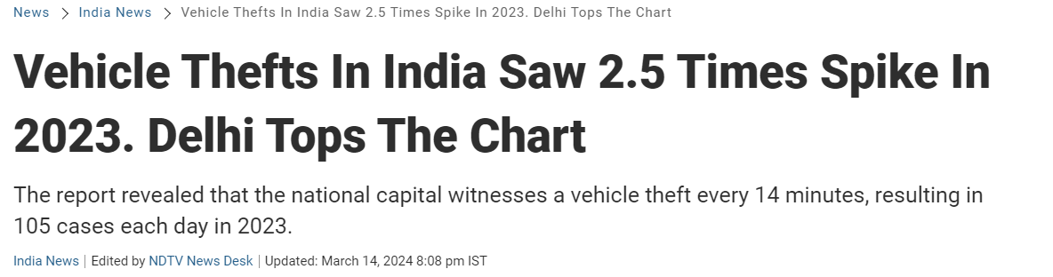

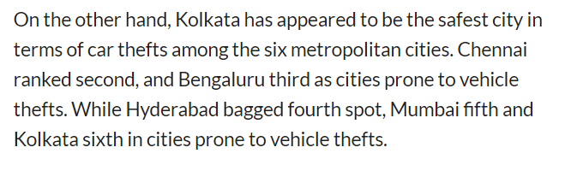
Motivation: Kolkata is 6th in the ranking of the car thefts in India. If the cars are parked only in the destined places we can reduce this number. That’s why we found a smart design that can be applicable for parking the cars that can reduce this amount and this is the motivation for our project work.

Slide 5
REQUIREMENT ANALYSIS SPECIFICATION:
Frontend
React
Backend
Node.js version 20.11.1
Express version 4.19.2
Mongoose version 8.4.0
Database
MongoDB
Browser
Internet Explorer and Others
User Requirements:
Internet Browser
& Some knowledge of English

Slide 6
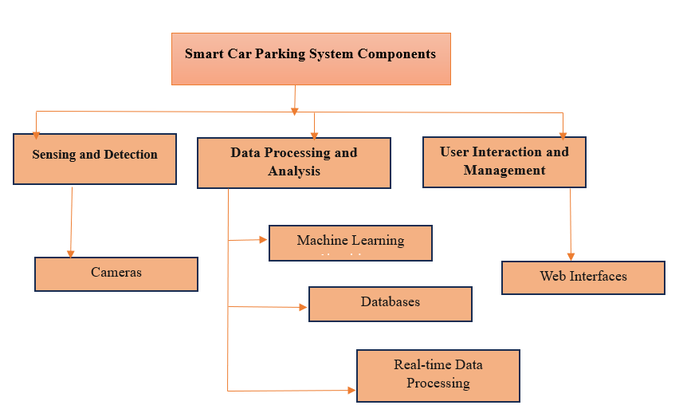
Components of our System:

Slide 7
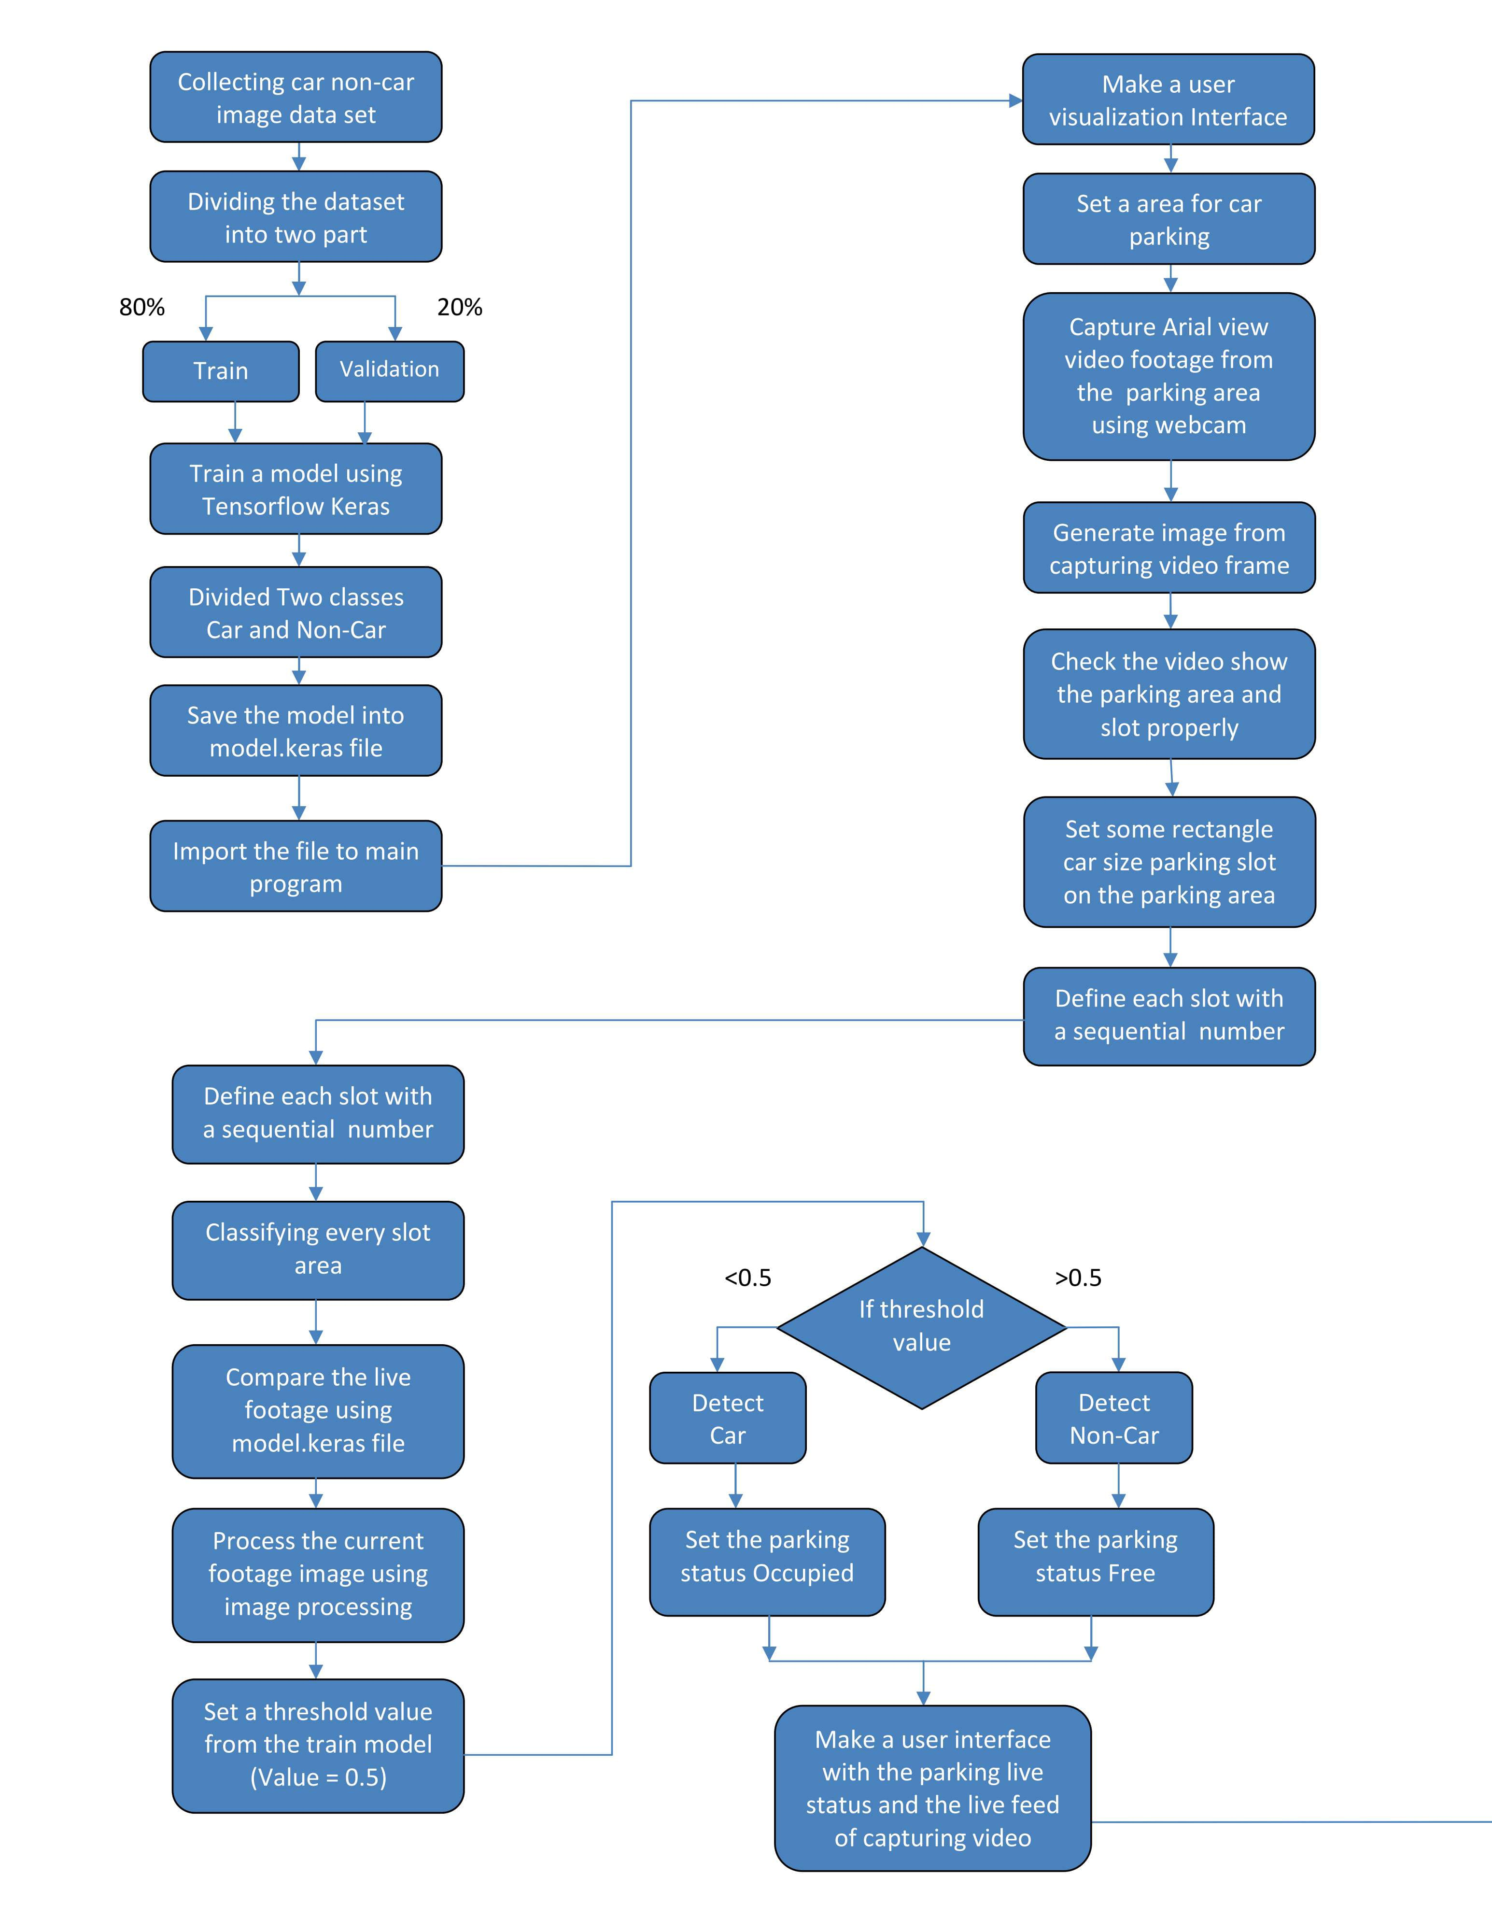
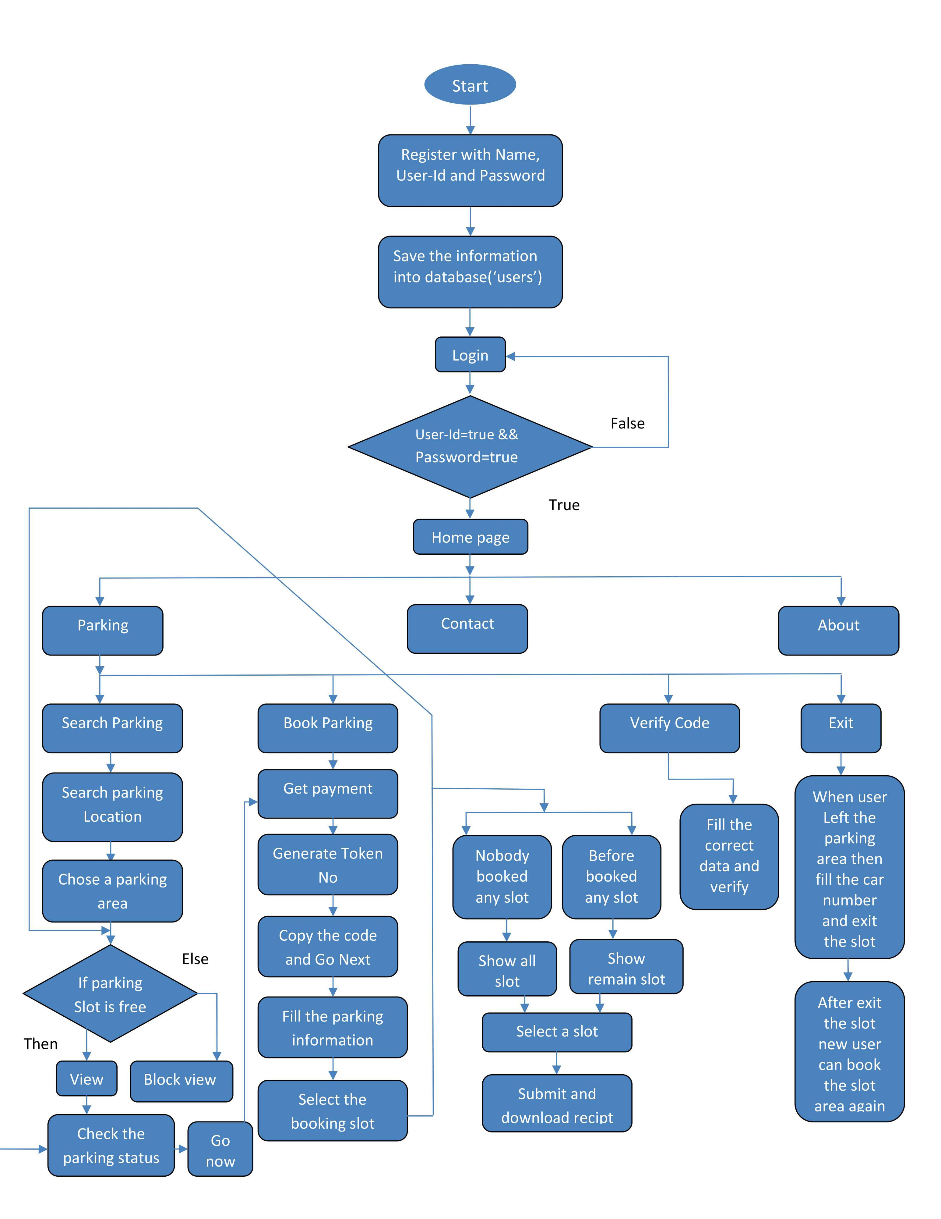
FLOW CHART

Slide 8
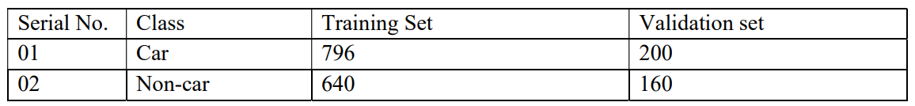
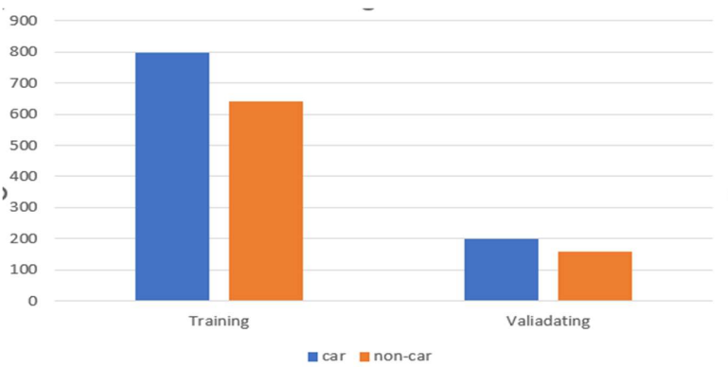
Data collection for the training purpose of car classification
We collect car and non-car image for two different dataset one for training purpose another for validations purpose . The training images are 1436 belong to two class(car,non-car).the validation images are 360 belongs to two class(car,non-car).

Slide 9
Car classification environment:
For the classification of car we have used the Convolutional Neural Network (CNN) Model
A Convolutional Neural Network (CNN) is a type of Deep Learning neural network architecture commonly used in Computer Vision. Computer vision is a field of Artificial Intelligence that enables a computer to understand and interpret the image or visual data.

Slide 10
Car Non car classification by CNN model:
First we trained the model with real time data augmentation to generate batches of training and validation.
Then we built the CNN mode, Add convolutional layers with activation functions (ReLU), followed by max-pooling layers.
- Flatten the output and add dense layers with ReLU activation.
- Include dropout layers for regularization and a final dense layer with sigmoid activation for binary
classification.

Slide 11
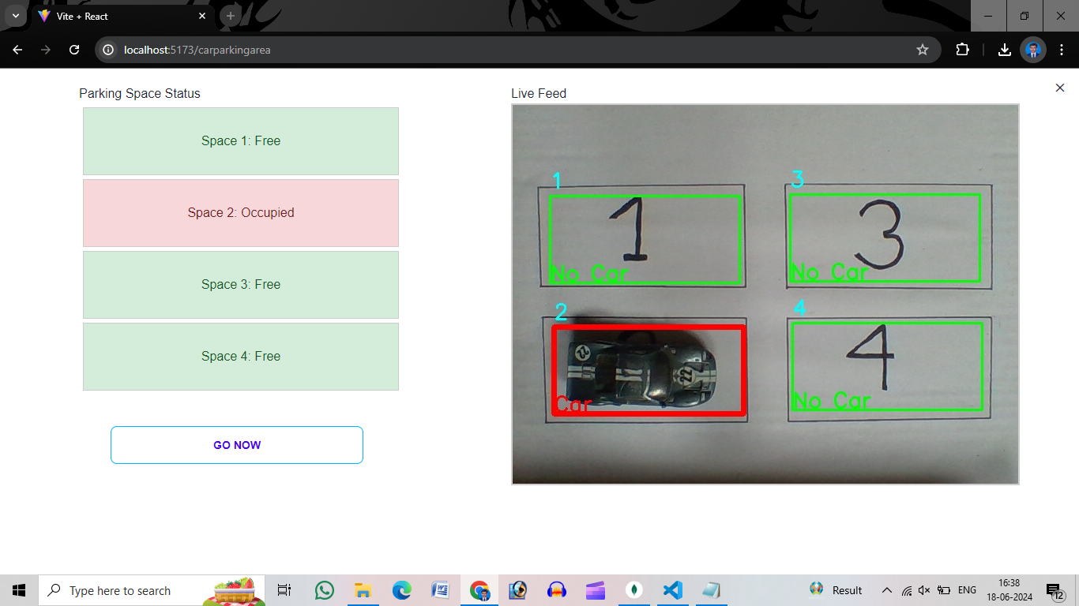
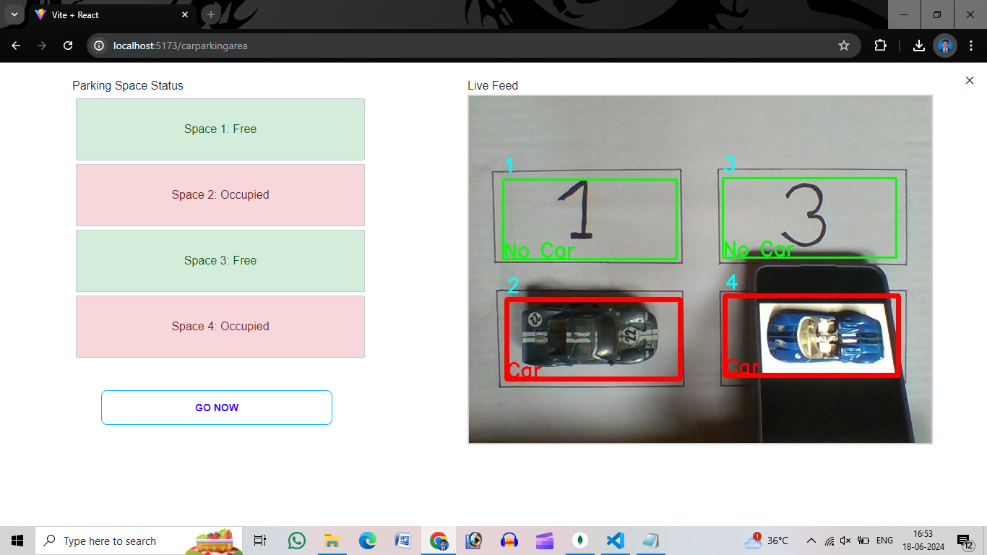
Implementation:
Machine Learning for car classification
We have trained our model such that it can recognizes the car, so when in the parking slot it can recognizes a car then in the live feed view it show that there is a car so when a user views the parking slot he becomes aware about the free and occupied parking area.
Free Space, user can book
Occupied Space, already booked by another user. One can book it when the existing user exits.

Slide 12
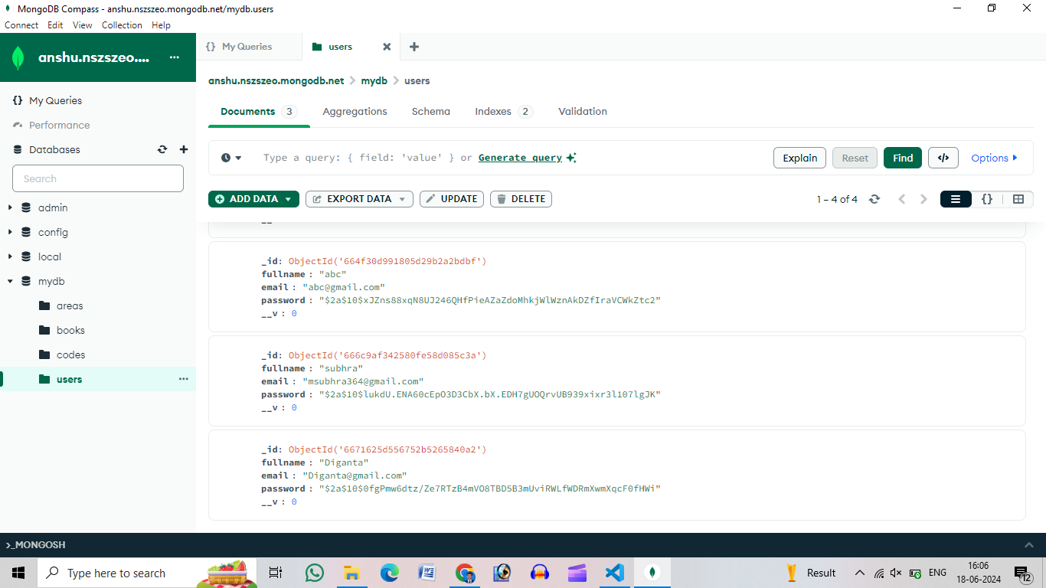
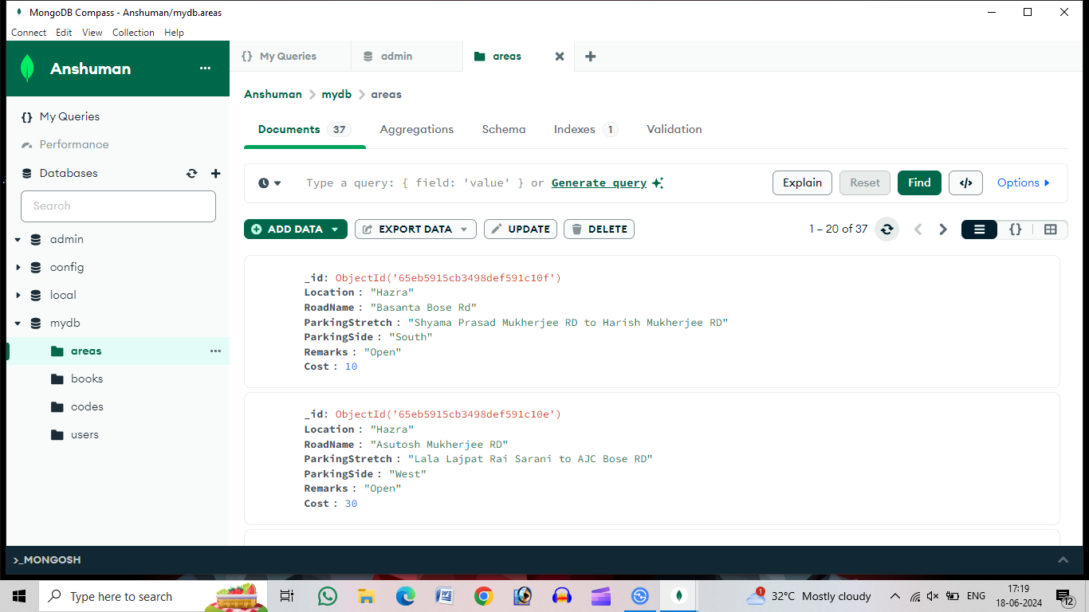
Data and how they are stored in the database
Here are the details of the users that is stored in the database
These are the details of the parking areas that are stored in the database

Slide 13
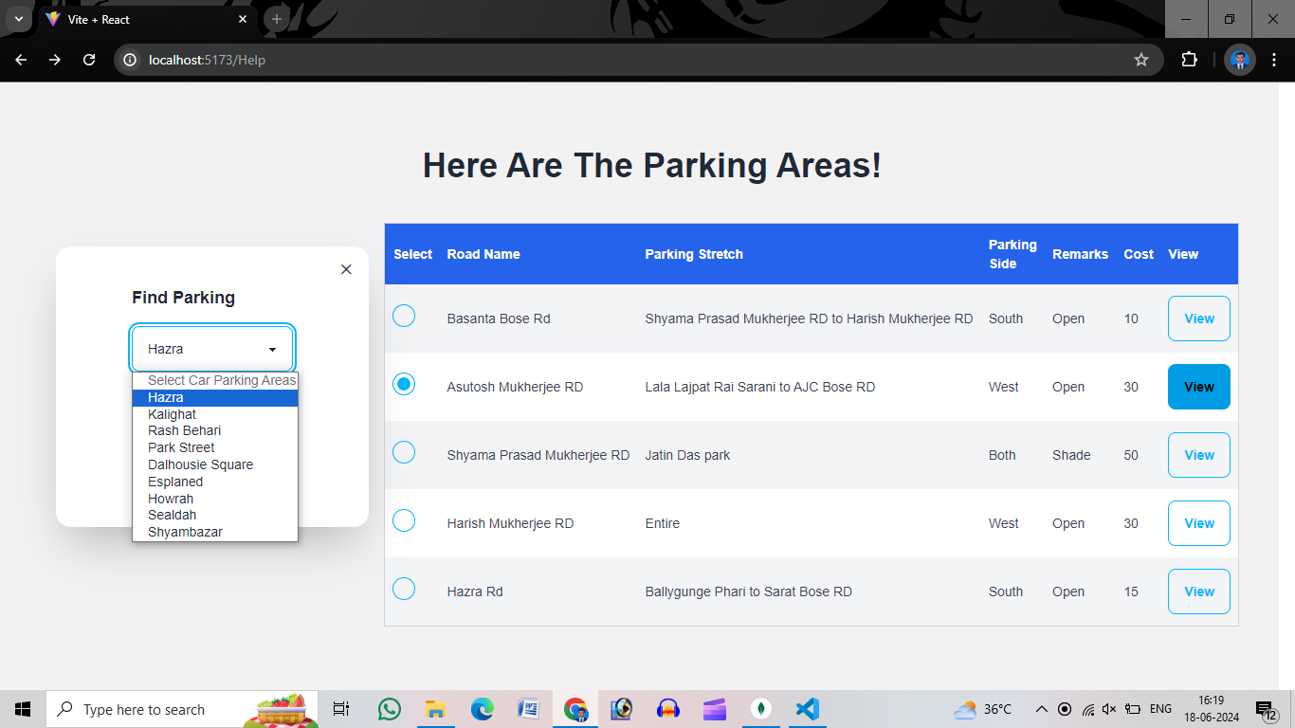
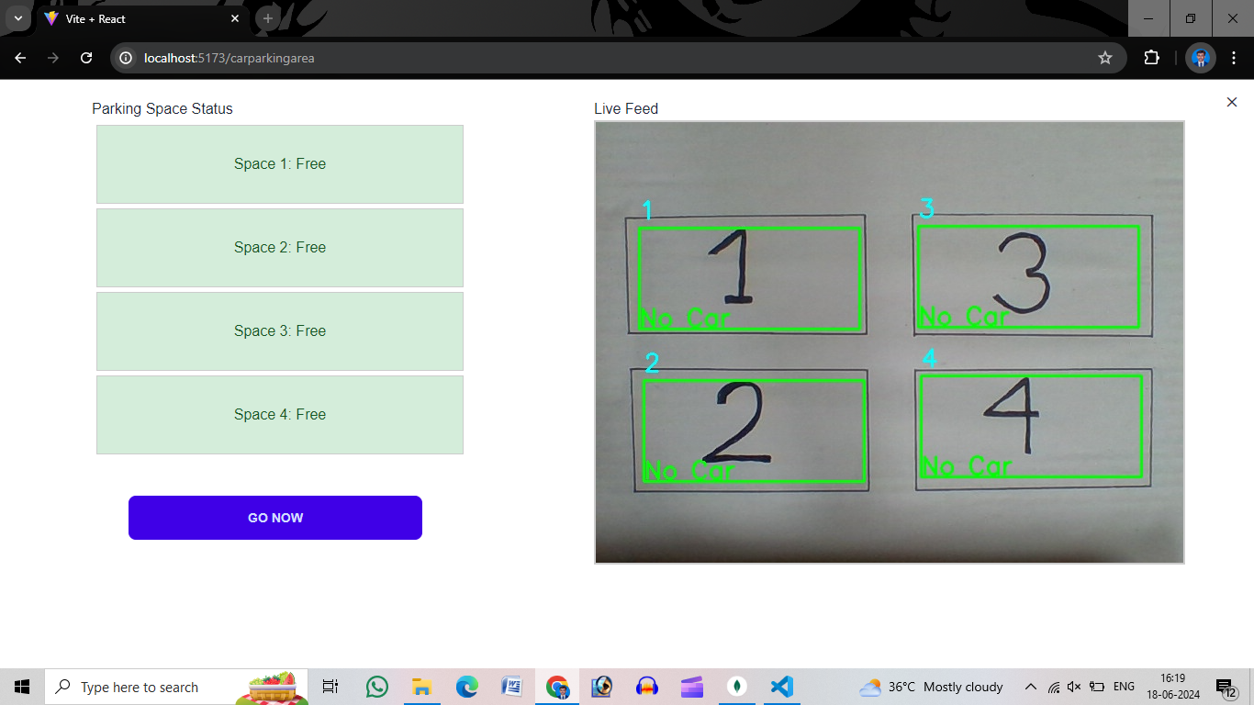
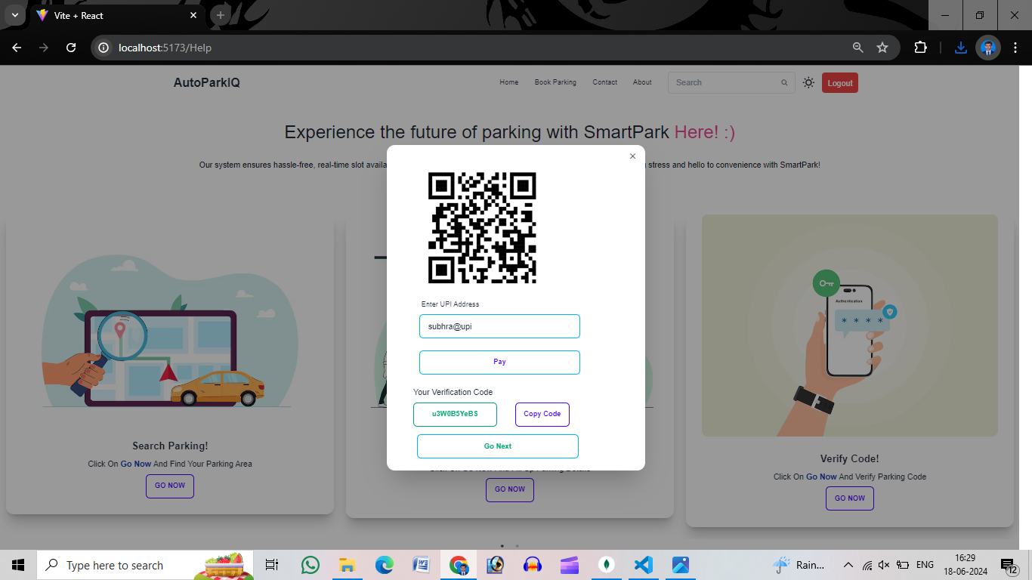
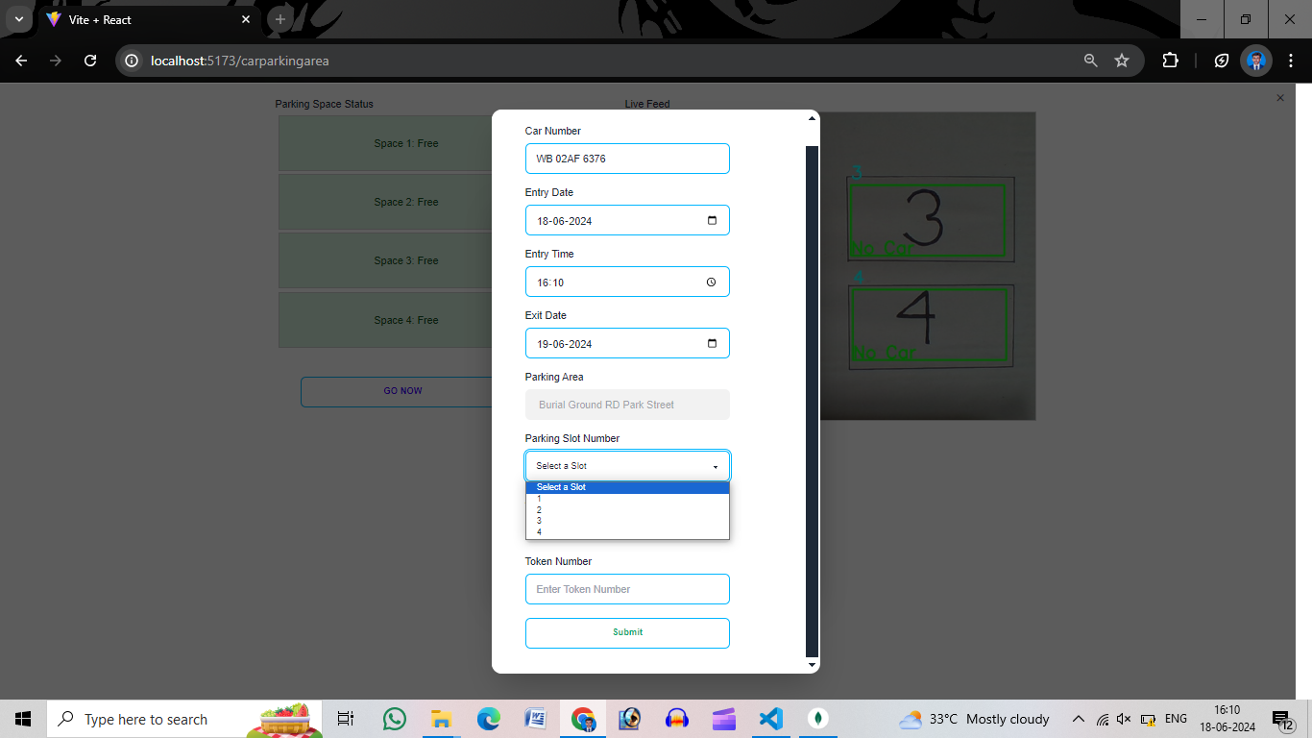
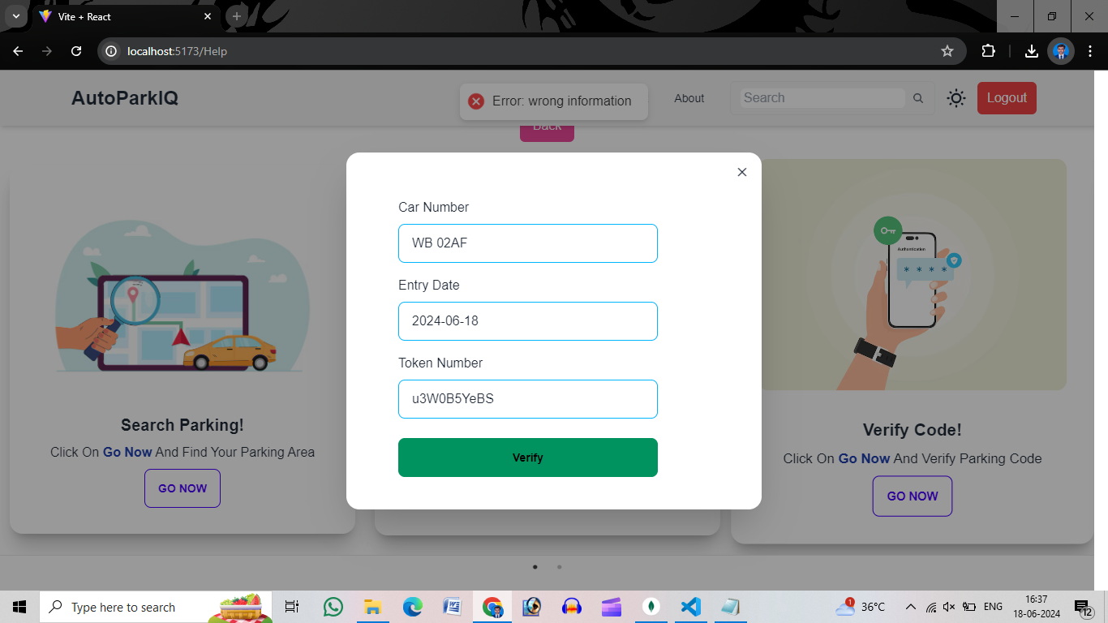
Example:

Slide 14
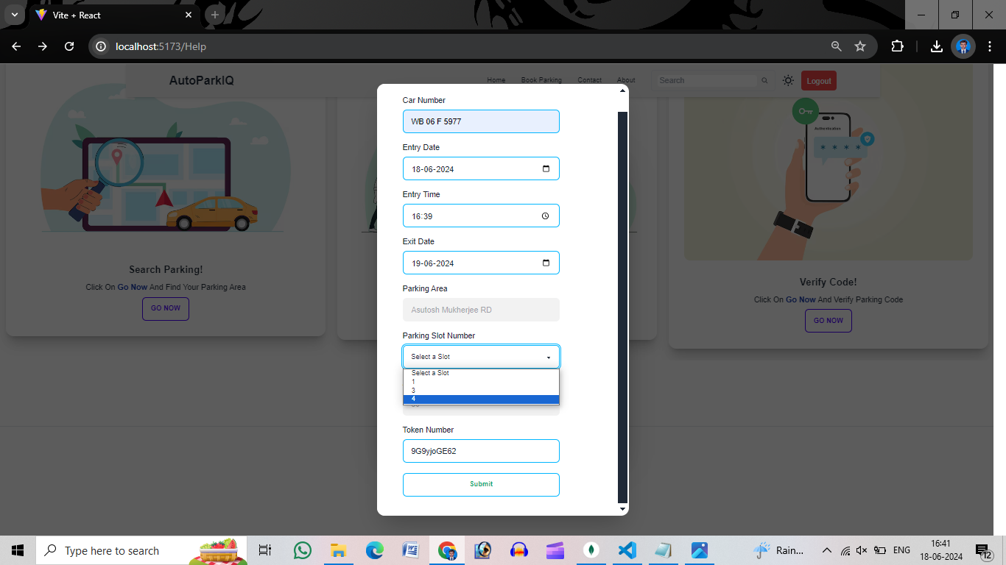
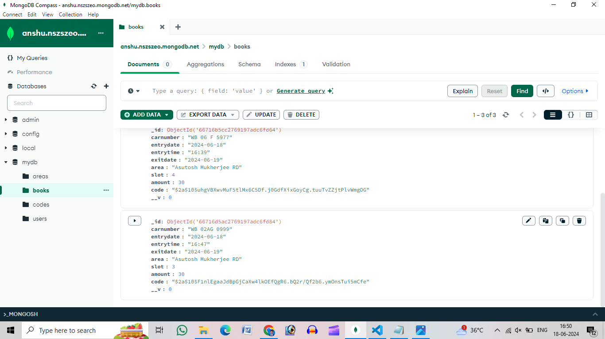
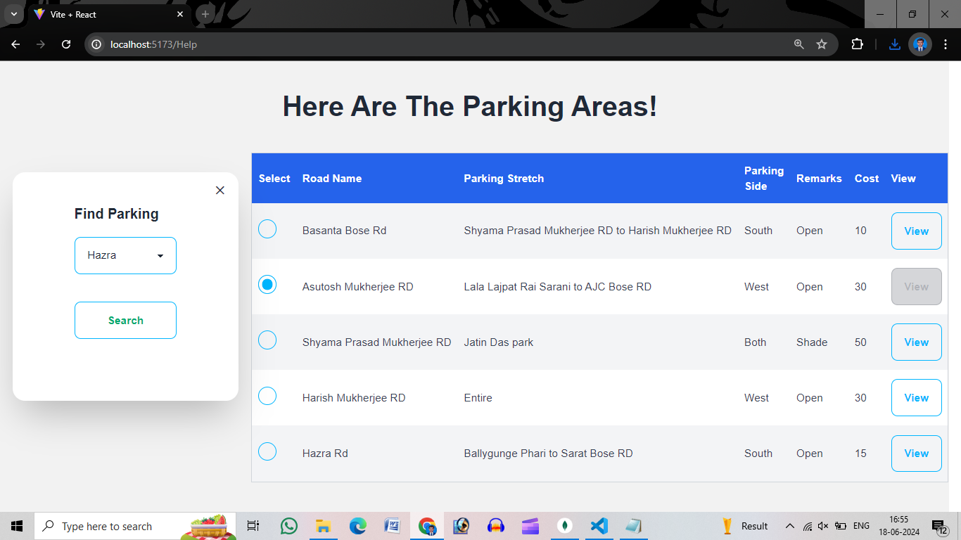
When a user books a slot all the details (the slot, the parking area, parking time, car number etc.) are stored in the database.
This part is connected with our frontend interface that when a slot is booked no other driver can book that place and also when all the slots of a parking area is currently full other users cant view that area for booking.

Slide 15
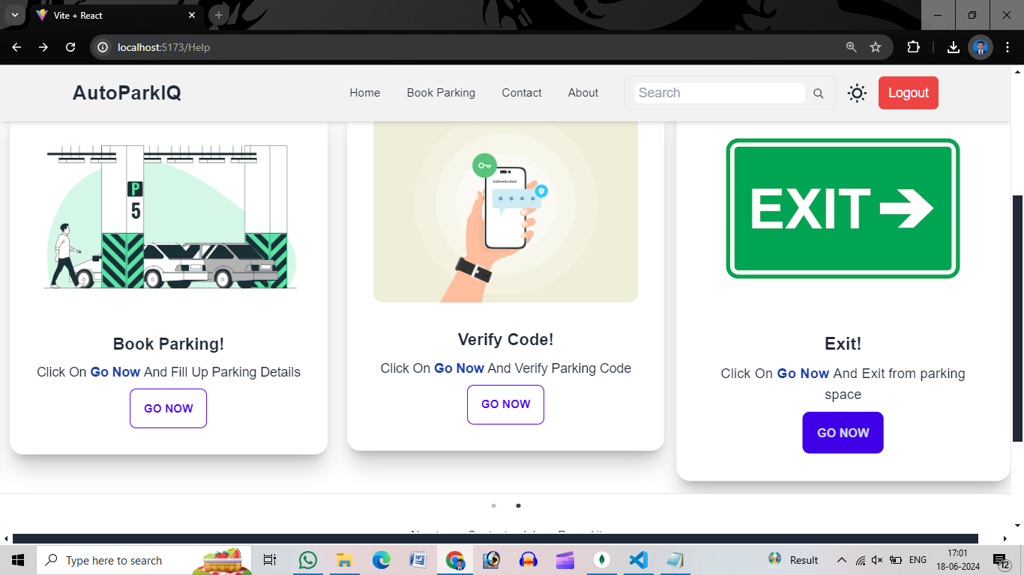
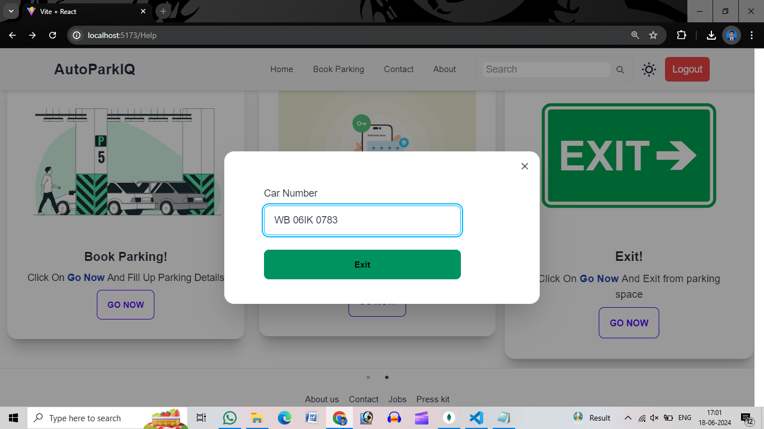
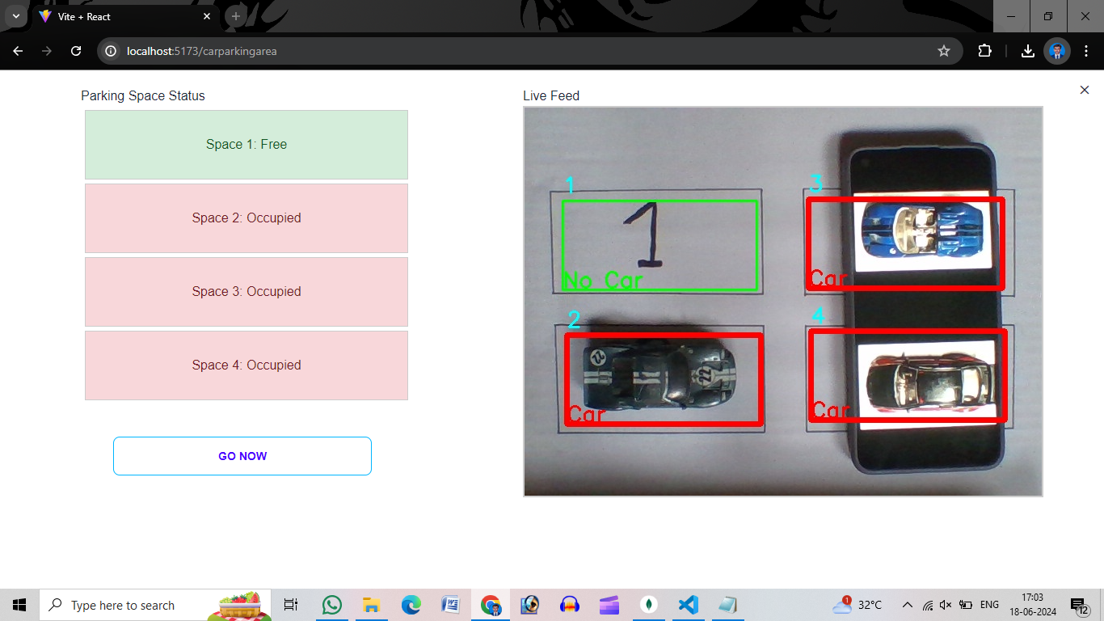
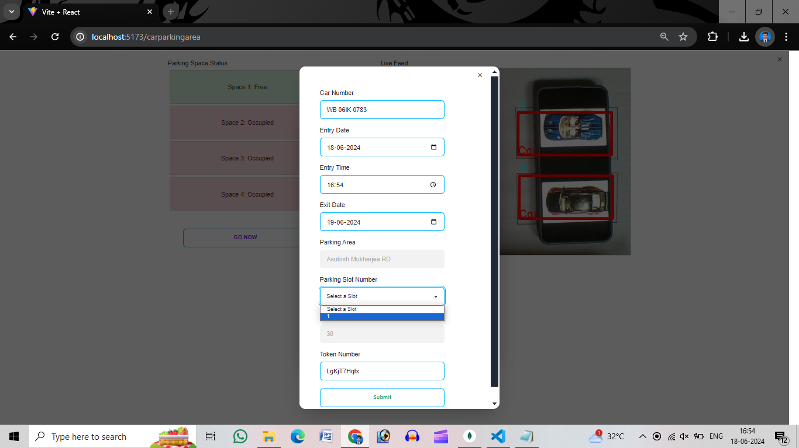
Example(When a user want to exit from the parking area):

Slide 16
Conclusion and Future work:
In Future we will add a feature that if a user don’t come in proper time his booking will be cancelled, and the slot will be freed.
In the future, we plan to implement a two-step verification process using number plate recognition. This will ensure that only the booked car is parked in the designated slot, preventing security issues where a different car occupies the reserved space.
Additionally, we aim to integrate a feature that suggests parking areas based on weather predictions. For example, if rain or thunderstorms are imminent, our system will recommend shaded parking slots to the driver.
The dynamic change of cost by passing time and other required decisions will be added in future.
By incorporating these features and more, we can further improve the convenience and reliability of our parking system for users.

Slide 17
Acknowledgement:
I take this opportunity to express profound sense of gratitude and respect to all those who helped me throughout the duration of this project.
First and foremost, I would like to thank my supervisor of this project, Shilpa Saha, and also Prof. Sk. Mohiuddin for their valuable time and guidance. Their willingness to motivate me has contributed tremendously to my project.
I would also like to thank Prof. Antika Sinha, Head of Department of Computer Science, for providing with a good environment and facilities to work on this project.
I regret any inadvertent omissions.

Slide 18
References:
Kong, Longin, et al. [1]:This paper presents a comprehensive survey of Convolutional Neural Networks (CNNs), highlighting their architecture, key components, and various applications.
Alam, M., Moroni, D., Pieri, G., Tampucci, M., Gomes, M., Fonseca, J.,.. . Leone, G. R. (2018). Real Time Smart Car Parking System Integration in Distributed ITS for Smart Cities. Journal of Advanced Transportation, 2018.[2]
www.google.com
docs.opencv.org
www.youtube.com
numpy.org
www.geeksforgeeks.org

Slide 19
Thank you

